Slide 1
The Origin of Islam

Slide 2
****The Origin Of Islam****
* Originated on the ARABIAN PENINSULA.
* The Arabs traced their ancestry to Abraham and his son Ishmael, who built the Kabba @ the city of Makkah (Mecca).
* This was a house of worship for the one true God, and whose cornerstone was a holy (sacred) stone, called the Black Stone.
* Arabs called this one true God, ALLAH.

Slide 3
Arabian Peninsula

Slide 4
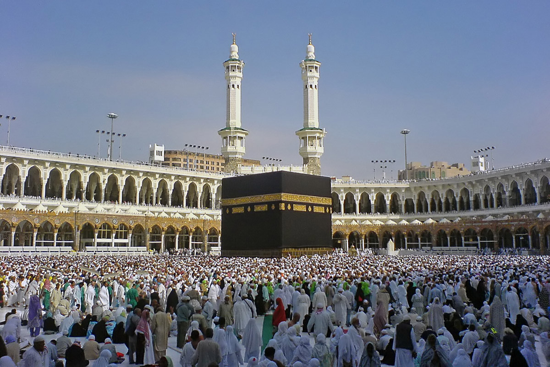
The Kaaba @ Makkah

Slide 5
***The Prophet Mohammad***
* Born in Makkah in 570 A.D. to a merchant family of traders.
* Married to Khadija, a wealthy widow.
* Became troubled by disparity between rich and poor. Meditated in hills around Makkah.
* Began receiving visions, and revelations from God in 610 A.D.
Arabic for God is “ALLAH”.
* The angel Gabriel brought these revelations and told him to recite:
* “THERE IS ONLY ONE GOD. HIS NAME IS ALLAH AND MUHAMMAD IS HIS PROPHET / HIS MESSENGER)”.
* Muhammad believed that Allah had already revealed himself in part to Moses and Jesus.
* Now the final revelations were being given to him.
* Out of these revelations, came the QURAN, the holy book of ISLAM, which means “peace through submission to the will of Allah”.
* Those who achieve this peace by submitting are called MUSLIMS.
* Muhammad converted his wife and others, but in 622 A.D. moved with his family and followers to MADINAH (MEDINA) aka “City of the Prophet”.
* This journey is known as the HIJRAH, and year 1 of the Muslim calendar.

Slide 6
Principles of Islam
Emphasizes salvation and offers the hope of an afterlife.
Those who desire to achieve life after death must subject themselves to the will of Islam.
Does not believe that Muhammad was divine. He is considered a prophet, like Moses and Jesus.
Muslims believe that because humans rejected Allah’s earliest message, Allah sent his final revelations through Muhammad.
The faithful who follow the Five Pillars are guaranteed a place in Heaven.
After Muhammad’s death in 632 A.D. Muslims scholars developed a law code called SHARI’AH.
It applies regulations for daily life.
The Five Pillars of Islam
* Believing there is only one god, Muhammad is his messenger.
* Prayers 5 times a day.
* Giving to the poor.
* Fasting during Ramadan, the holiest month for Muslims.
* A trip to Makkah (Hajj).

Slide 7
Temple Mount and the Western Wall

Slide 8
Islamic Jihad
*
In 630 A.D. Muhammad returned to Makkah and forced the city to surrender.
This was the first Jihad, or holy war.
The Kaaba declared a sacred site.
In 632 A.D. Muhammad died.

Slide 9
Sunnis v. Shiites
After Ali’s death, the group known as Shiites believed only Muhammad’s descendants were the true leaders of Islam.
Sunnis believed any capable leader should be accepted.
Those two groups are still waging war on each other today.
After Muhammad’s death in 632 A.D. Muslim scholars developed Shari’ah, a set of laws to regulate daily life.
Abu Bakr, Muhammad’s father-in-law became caliph, successor to Muhammad.
In 656 Ali, was chosen as successor. He was Muhammad’s son-in-law.

Slide 10
Achievements of islam
The Hadith, an early collection of Mohammad’s messages; warns against any attempt to imitate God.
Translated the works of Plato and Aristotle into ARABIC.
Created the House of Wisdom in Baghdad, which became the new capital by 762 A.D.
Gave us the mathematical discipline of ALGEBRA.
* Developed an OBSERVATORY to study the stars.
* Ibn Sina wrote a MEDICAL ENCYCLOPEDIA, which was translated into Latin and used thru-out medieval times.

Slide 11
Achievements (cont’d)
Built the ALHAMBRA in Granada, Spain, one of the finest examples of Islamic art and palaces.
In literature, THE RUBAIYAT OF OMAR KHAYYAM and THE ARABIAN NIGHTS, are still being read and taught today.
* Gave us the poetry of RUMI, a renown pet still revered and studies today, especially in the Arabic world.

